Slide 1
Streamlining GitHub Setup: Harnessing SSH Keys for Effortless Git Cloning
Unlocking Efficiency and Security in Version Control through SSH Key Integration

Slide 2
Demystifying SSH: Secure, Efficient, and Essential
SSH (Secure Shell) is a cryptographic network protocol used for secure communication over an unsecured network. It provides a secure channel over an insecure network by using encryption and authentication mechanisms.
Security: SSH encrypts data transmitted between the client and server, protecting it from eavesdropping and tampering by malicious actors.
Authentication: SSH uses public-key cryptography to authenticate users and hosts. This means that even if someone intercepts the communication, they cannot impersonate either party without possessing the private key.
Convenience: SSH allows for passwordless authentication, making it easier and faster to access remote systems securely.
Remote Access: SSH enables users to securely access and manage remote systems, execute commands, transfer files, and tunnel network connections.

Slide 3
Unlocking Collaboration: The Power of Git Clone in Version Control
Git clone is a command used in Git, a distributed version control system, to create a copy of a repository (repo) from a remote server onto your local machine. This process allows you to access the entire history and files of the project, enabling collaboration, development, and synchronization between multiple contributors.
Access and Collaboration: Git clone enables seamless collaboration by providing each contributor with a local copy of the project. This allows for independent work on different features or branches while maintaining a cohesive codebase.
Version Control: By cloning a repository, you gain access to its complete version history. This means you can revert to previous versions, compare changes, and track modifications over time, ensuring project stability and accountability.
Offline Work: Once cloned, a Git repository resides on your local machine, allowing you to work offline. You can make changes, commit them to your local repository, and synchronize with the remote server once you're back online, ensuring productivity regardless of internet connectivity.
Backup and Redundancy: Having a local copy of the repository serves as a backup in case of server failure or data loss on the remote repository. It provides redundancy and peace of mind by ensuring that your work is not solely dependent on the remote server's availability.

Slide 4
Empowering Windows Users: Activating SSH via Command Prompt
Begin by searching for "cmd" in the search bar and launching Command Prompt.
Pay attention to the directory path displayed, typically starting with "C:\Users\User>". This is where the SSH folder will be generated.
Enter the following command: "ssh-keygen -t rsa -b 4096 -C 'your_email@example.com'". Make sure to replace 'your_email@example.com' with the email address associated with your GitHub account, as this will be used to generate the SSH key pair.

Slide 5
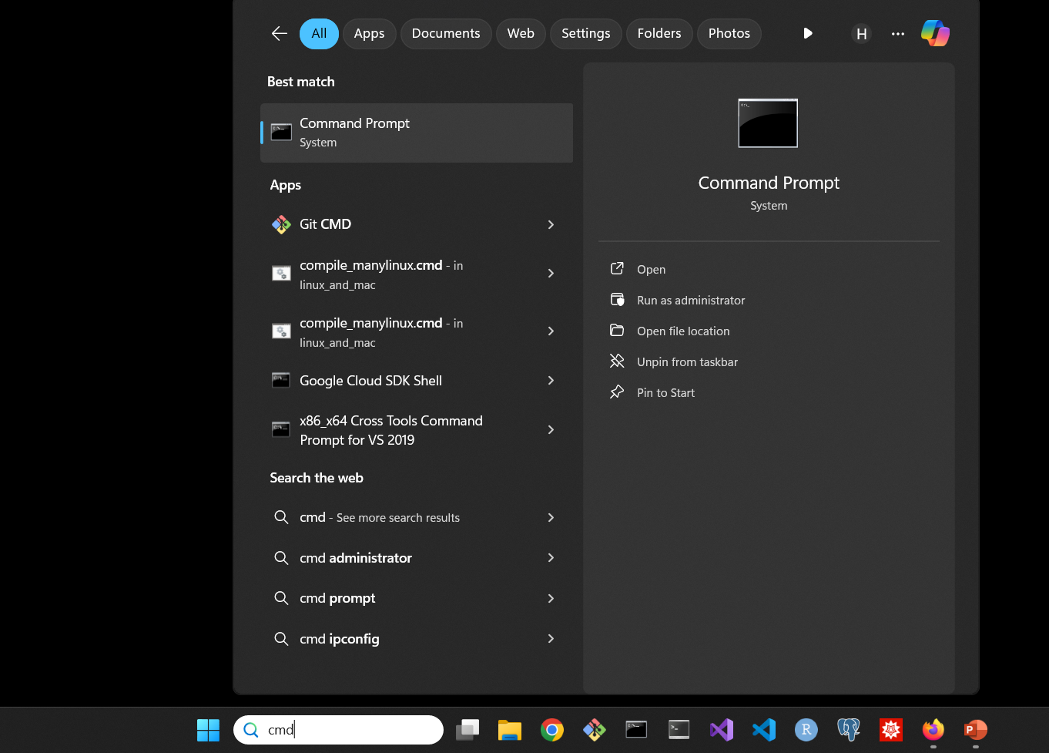
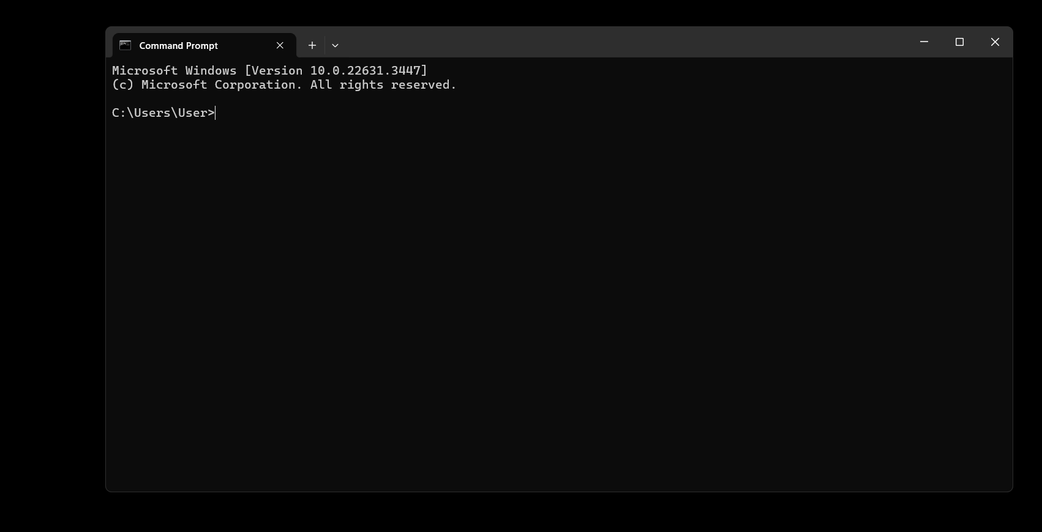
Empowering Windows Users: Activating SSH via Command Prompt

Slide 6
Empowering Windows Users: Activating SSH via Command Prompt
When you input the command: "ssh-keygen -t rsa -b 4096 -C 'your_email@example.com'", proceed by pressing the Enter key. If any message appears, simply press Enter without providing any additional input. Eventually, you'll see the fingerprint displayed.

Slide 7
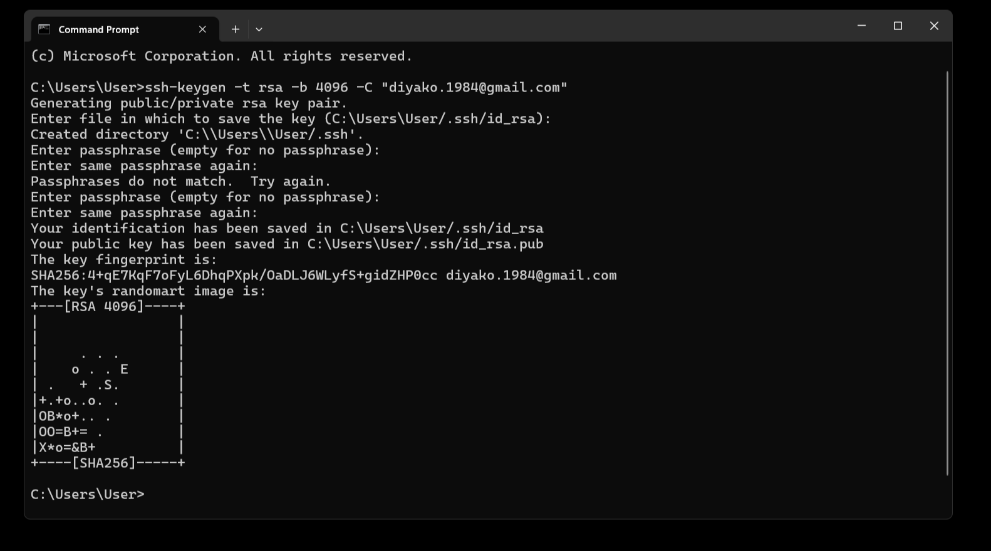
Empowering Windows Users: Activating SSH via Command Prompt

Slide 8
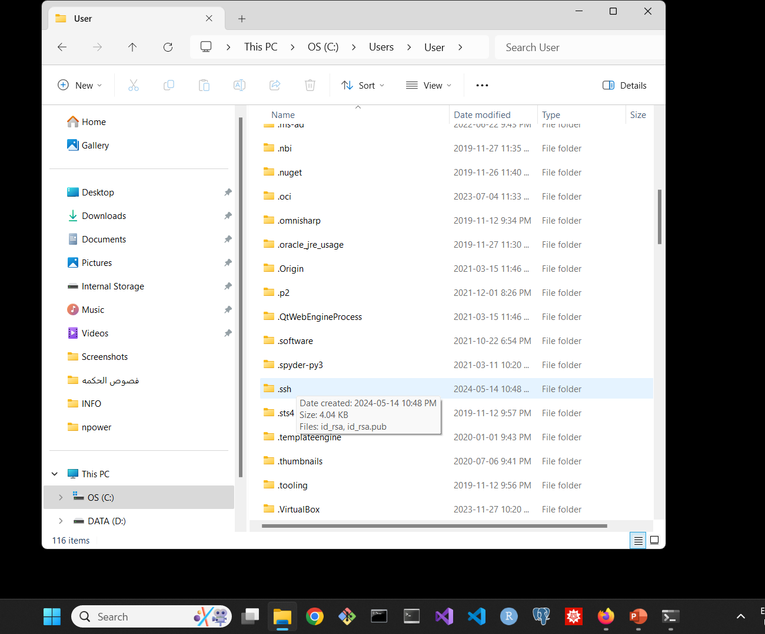
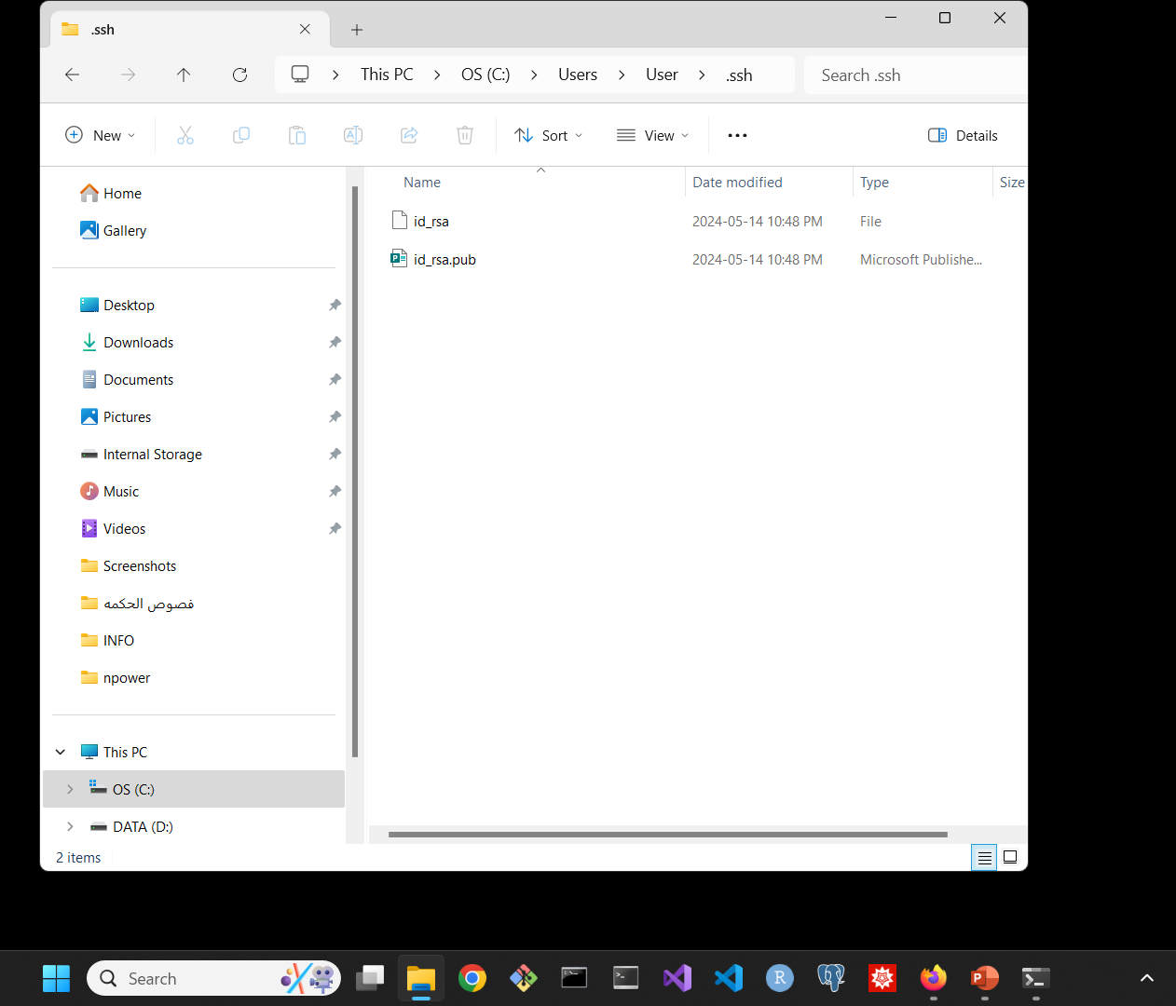
Next, navigate to the directory "C:\Users\User\" and locate the ".ssh" folder. Upon opening this folder, you'll find the "id_rsa.pub" file. Open a plain text editor such as Notepad, then drag the "id_rsa.pub" file into the text editor window. This allows you to view your SSH key generated by the keygen process.

Slide 9
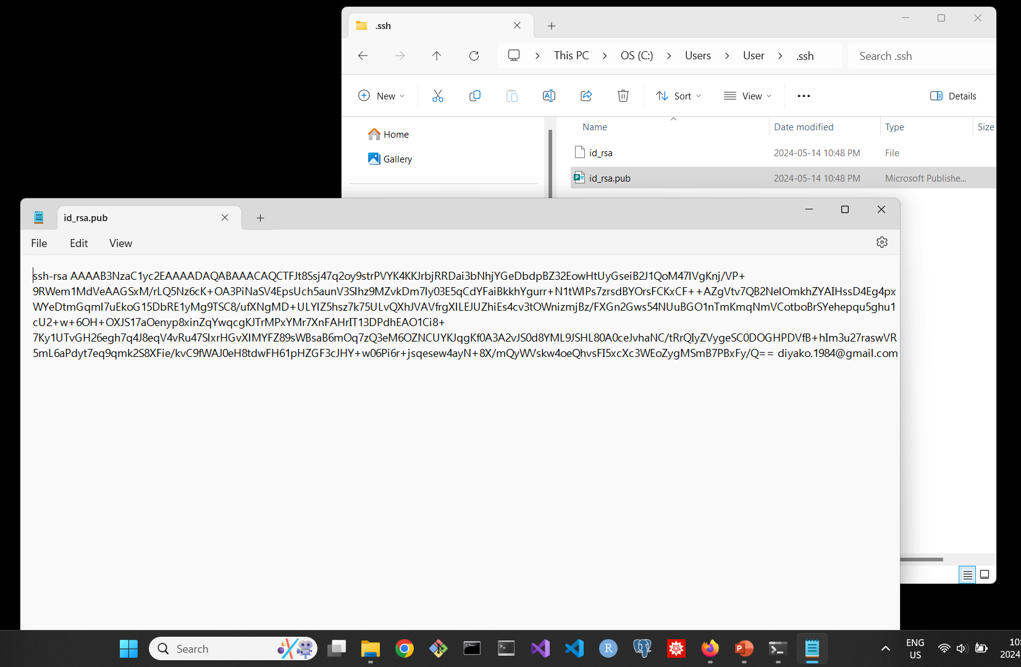
ssh-rsa…

Slide 10
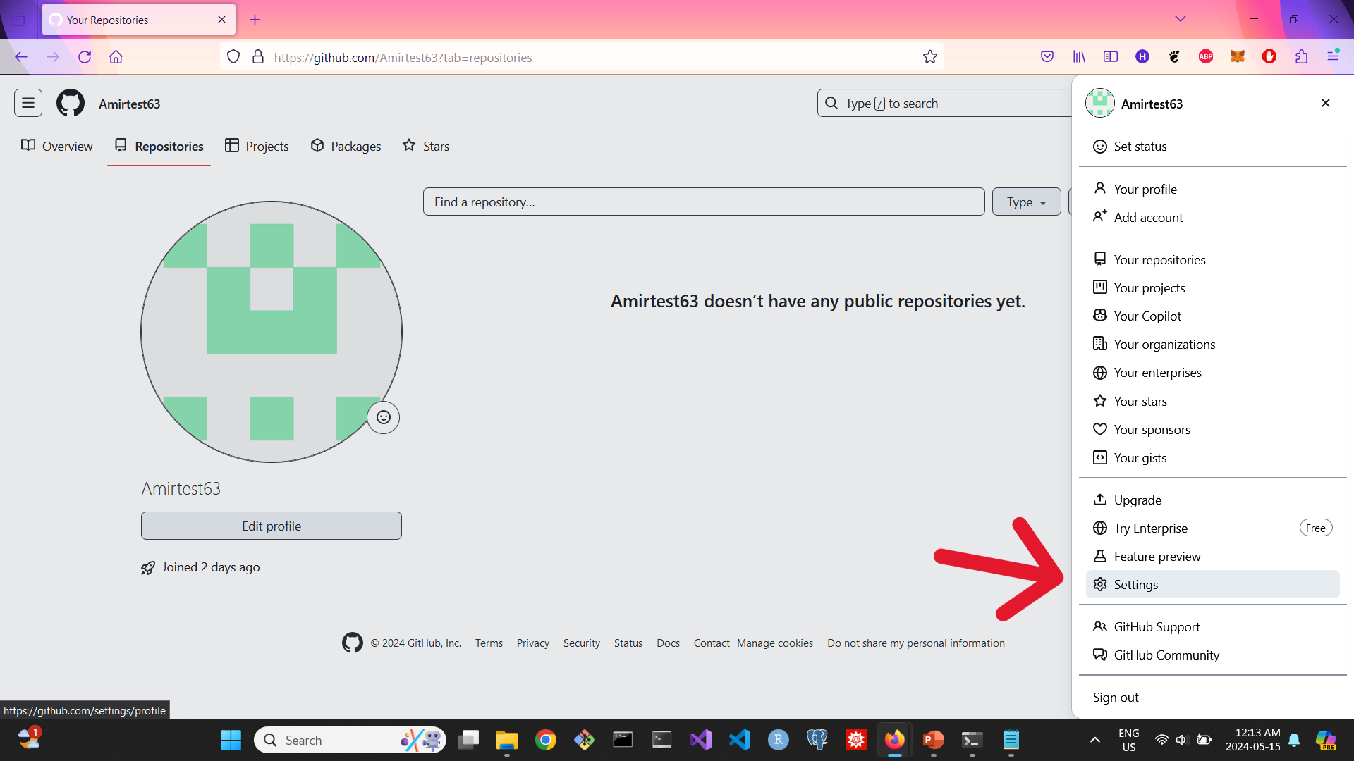
We'll now copy the SSH RSA key and insert it into GitHub. Head to GitHub's settings, found in the 'SSH and GPG key' section under the 'Access' menu. Click 'New SSH key'. Adding a title is optional. Paste the copied key into the provided window, and finally, hit 'Add SSH key' to finish.

Slide 11
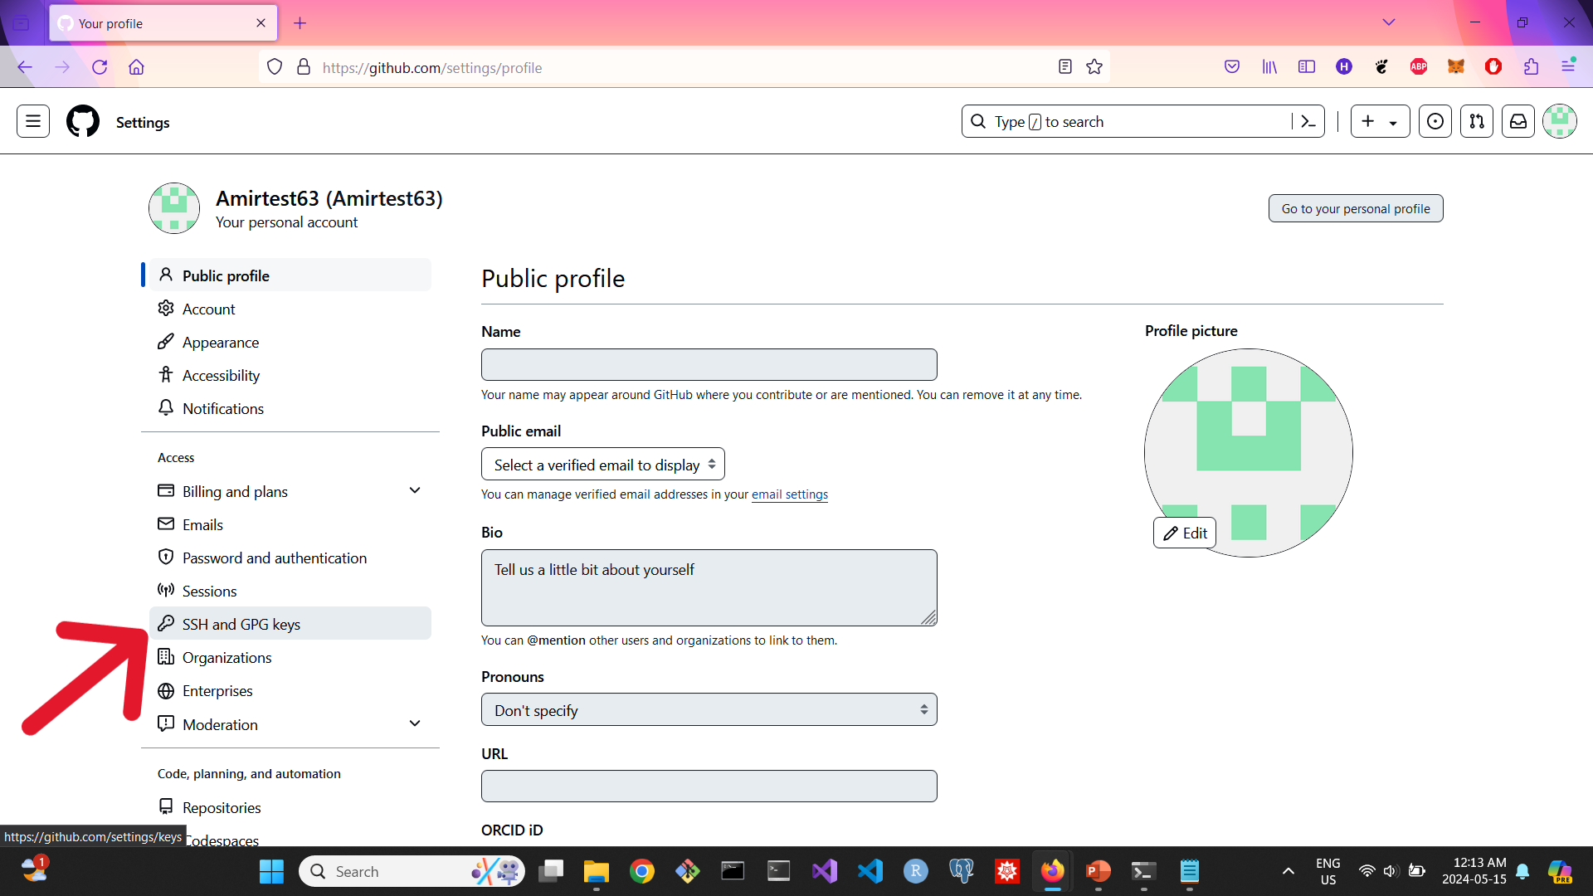
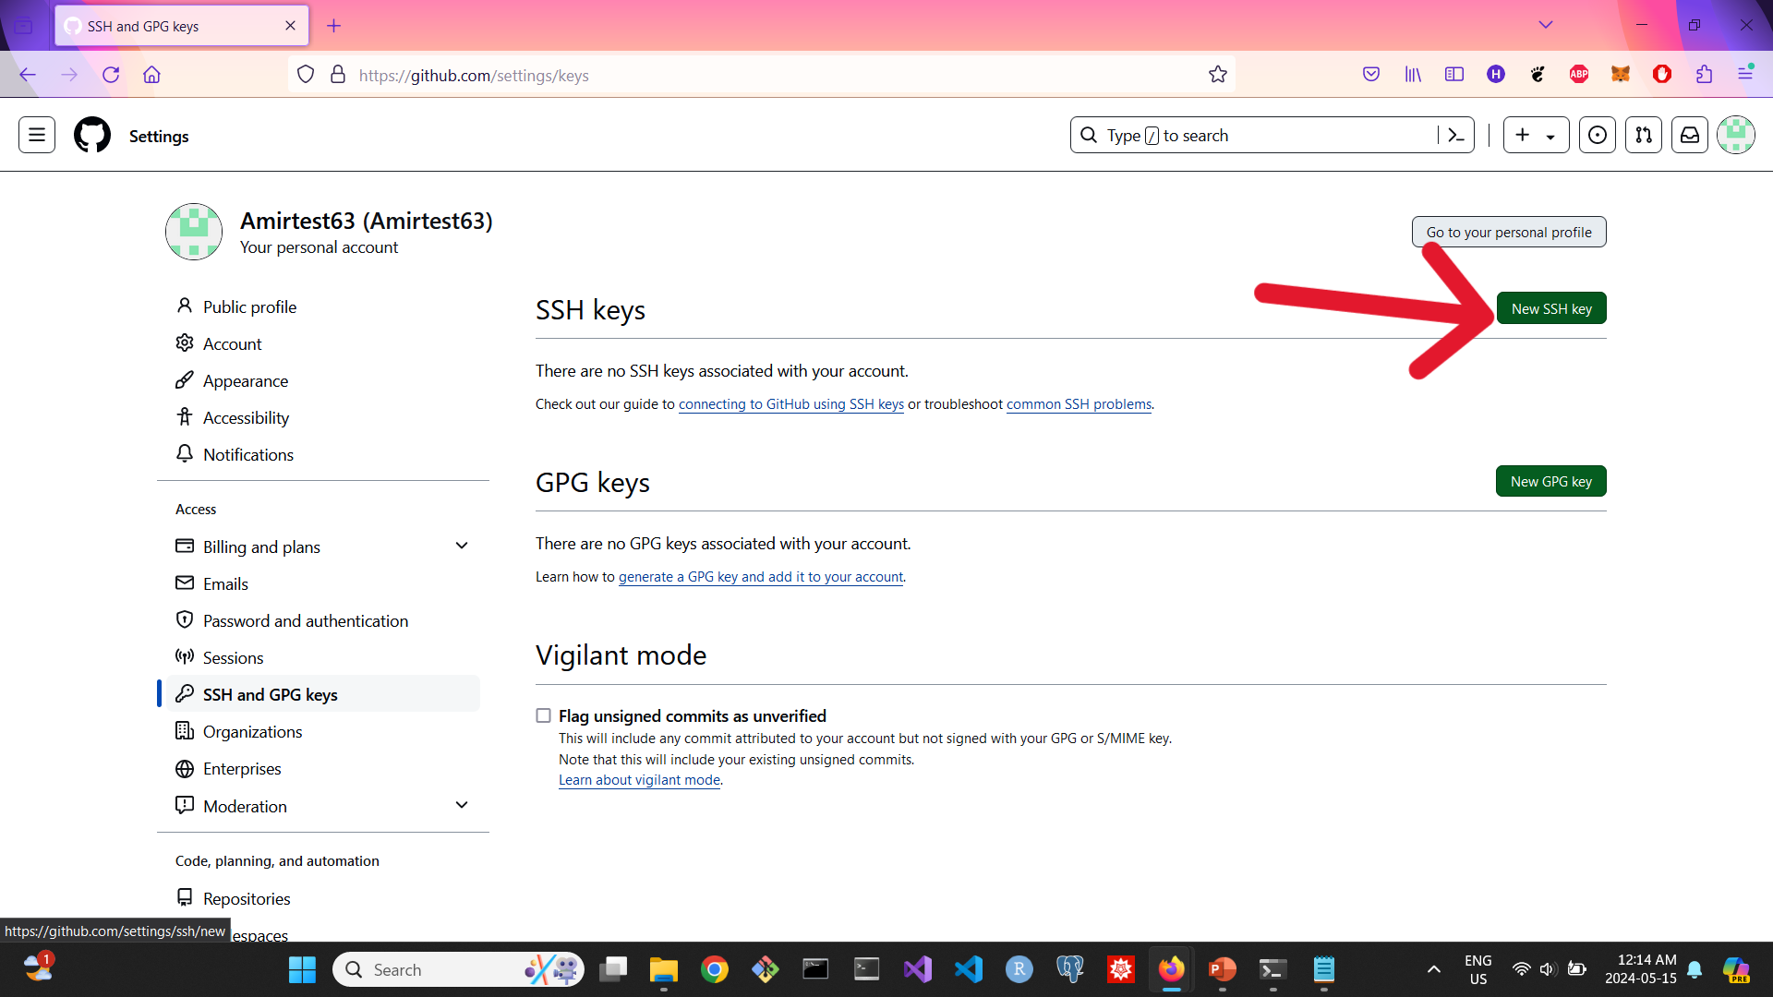
ssh-rsa

Slide 12
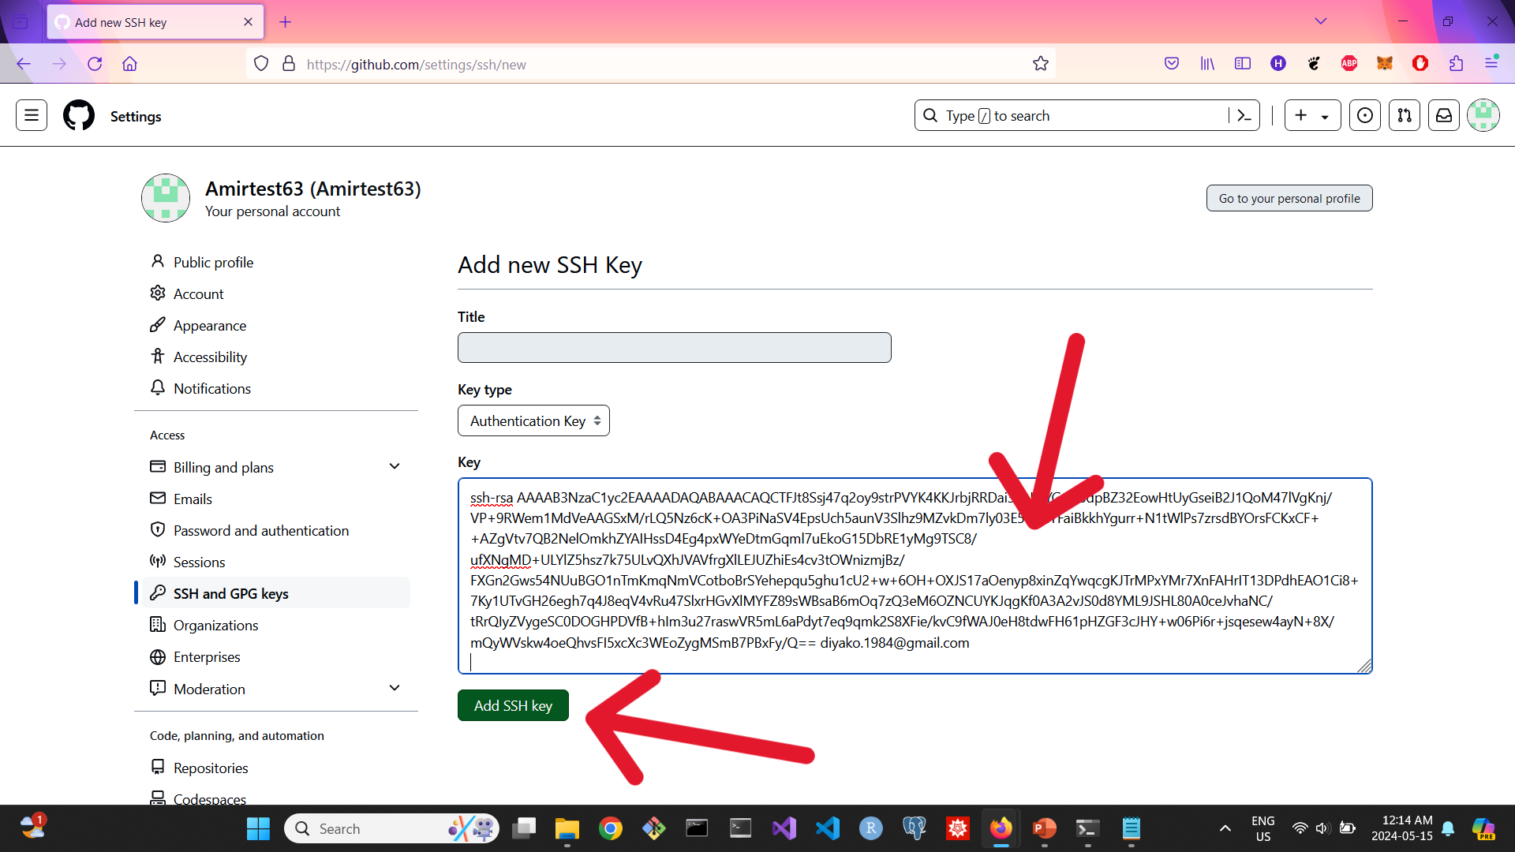
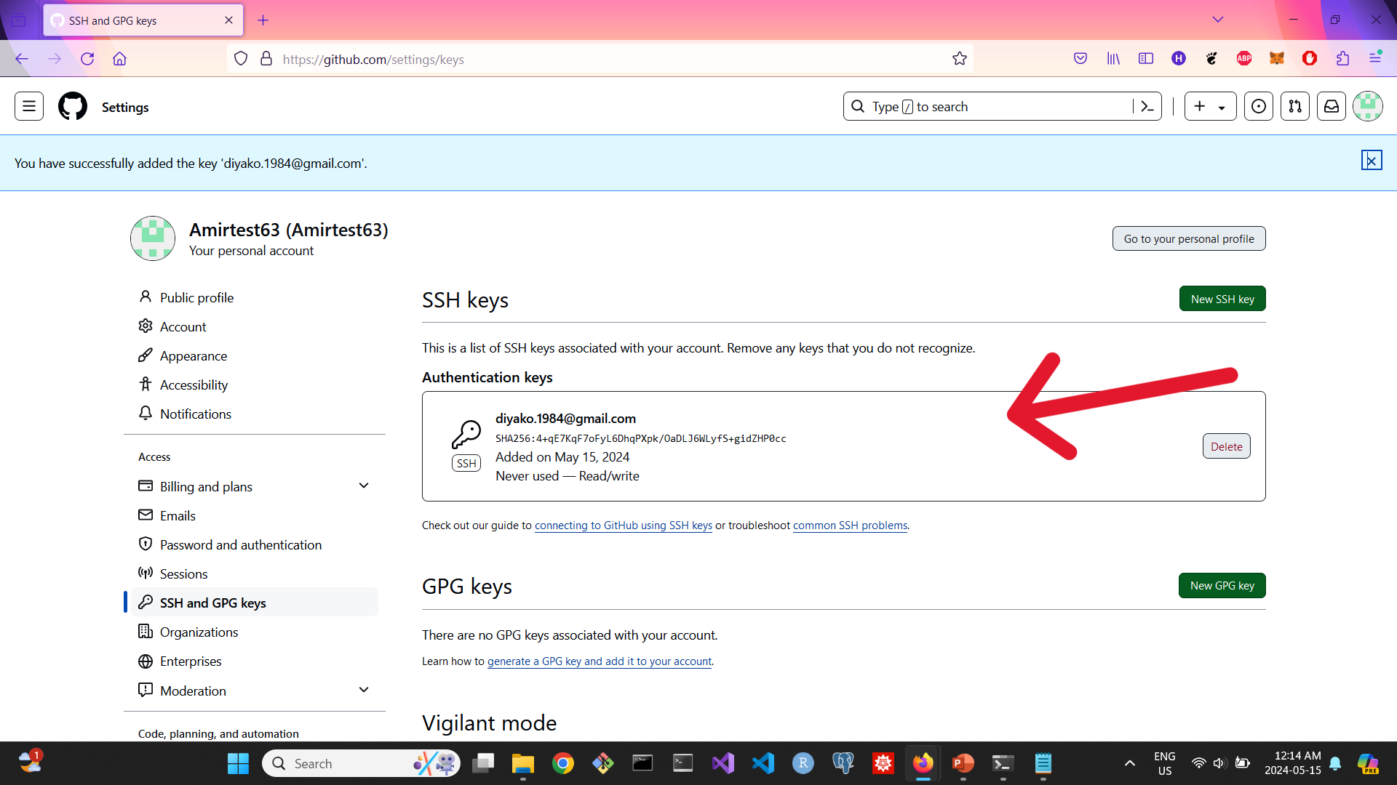
ssh-rsa

Slide 13
Setting Up Your Repository on GitHub: Creating and Cloning
Now, let's navigate to 'Your Repositories' and click the 'New' button. Here, we'll give our repository a name, select 'Public', add a README file, and then hit 'Create Repository'. Once created, click on the 'Code' button, where we'll find the SSH key and URL. Copy the URL for further use.

Slide 14
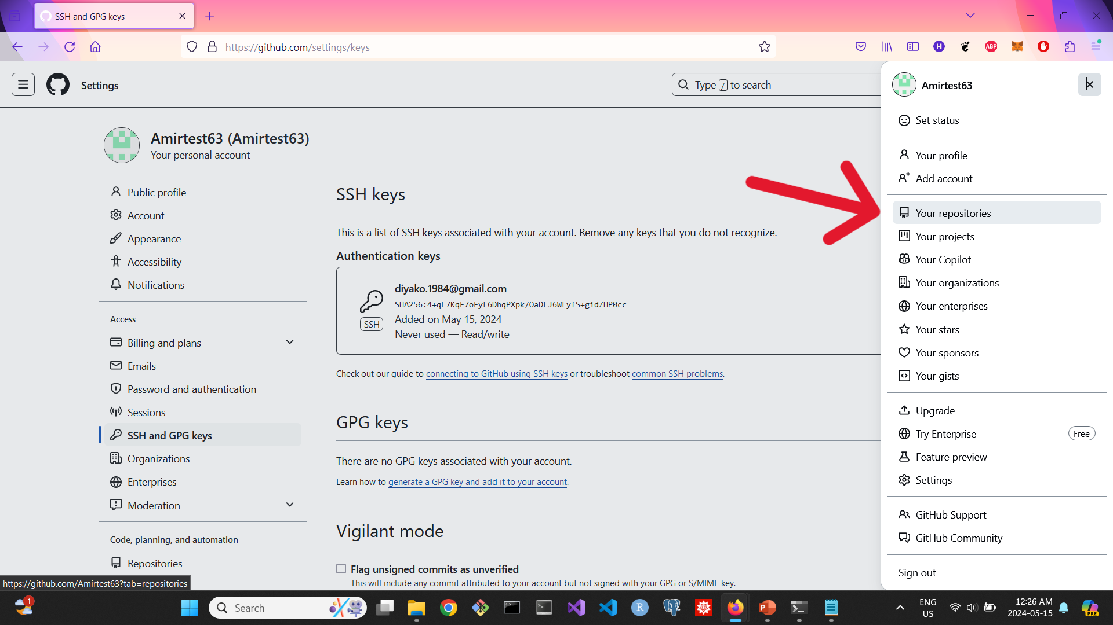
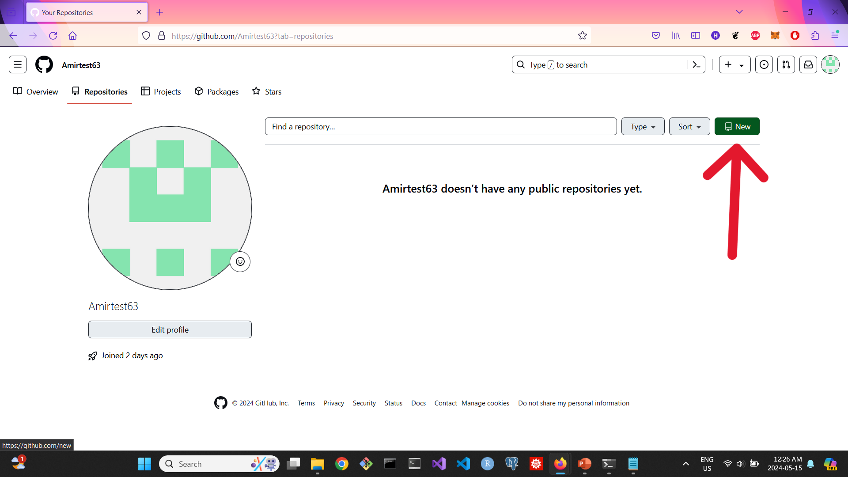
Setting Up Your Repository on GitHub: Creating and Cloning

Slide 15
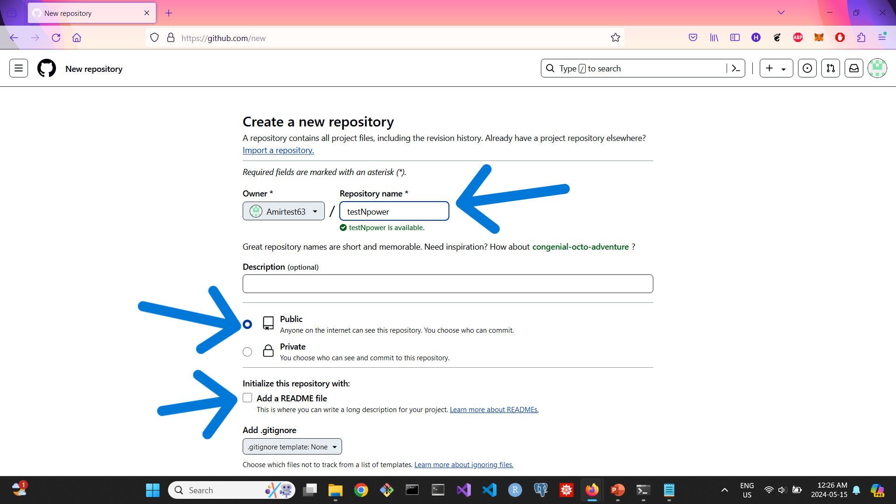
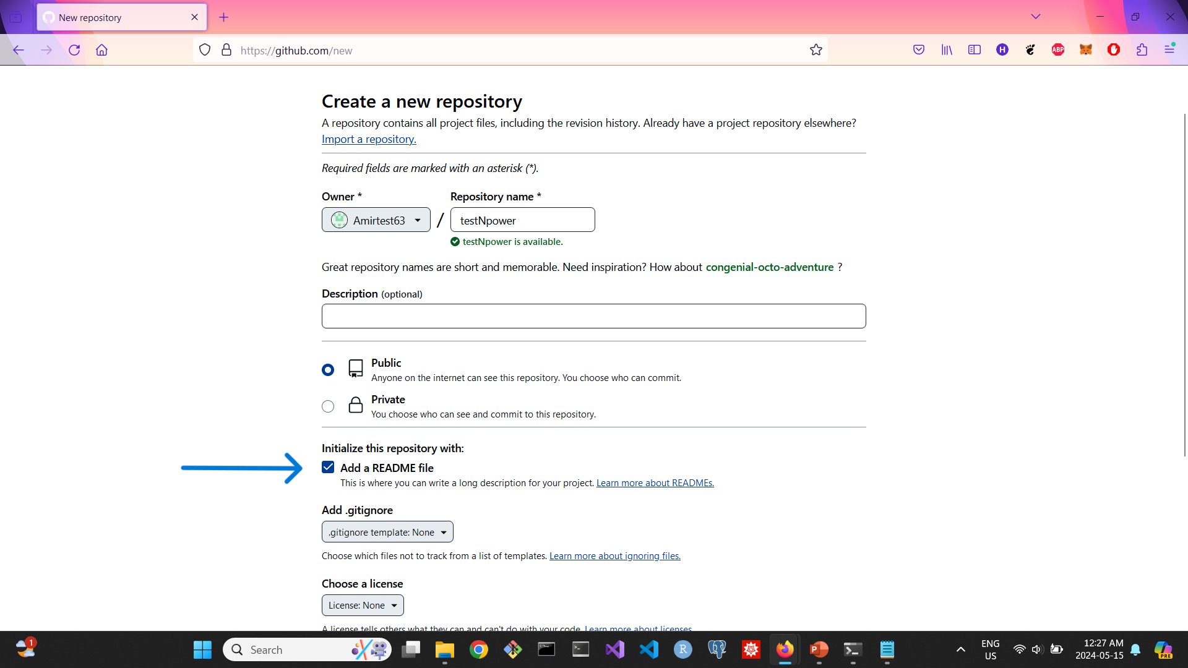
Setting Up Your Repository on GitHub: Creating and Cloning

Slide 16
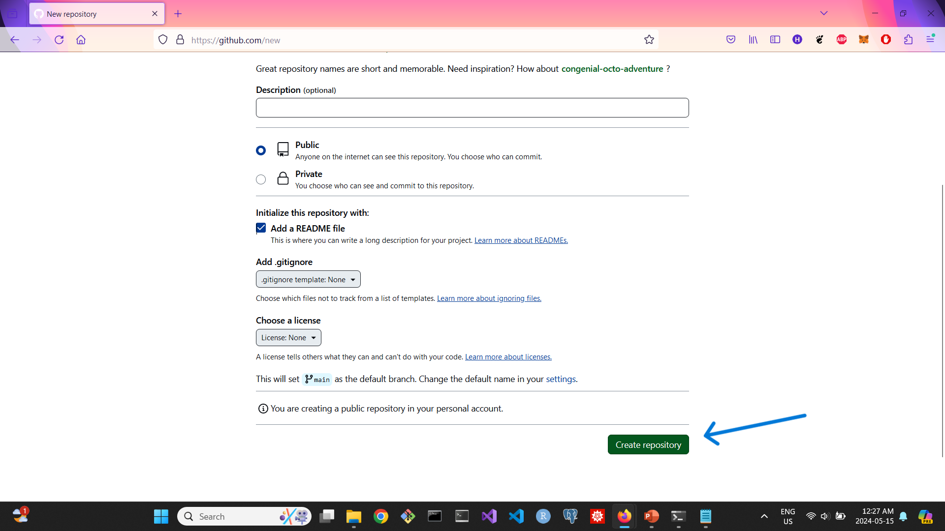
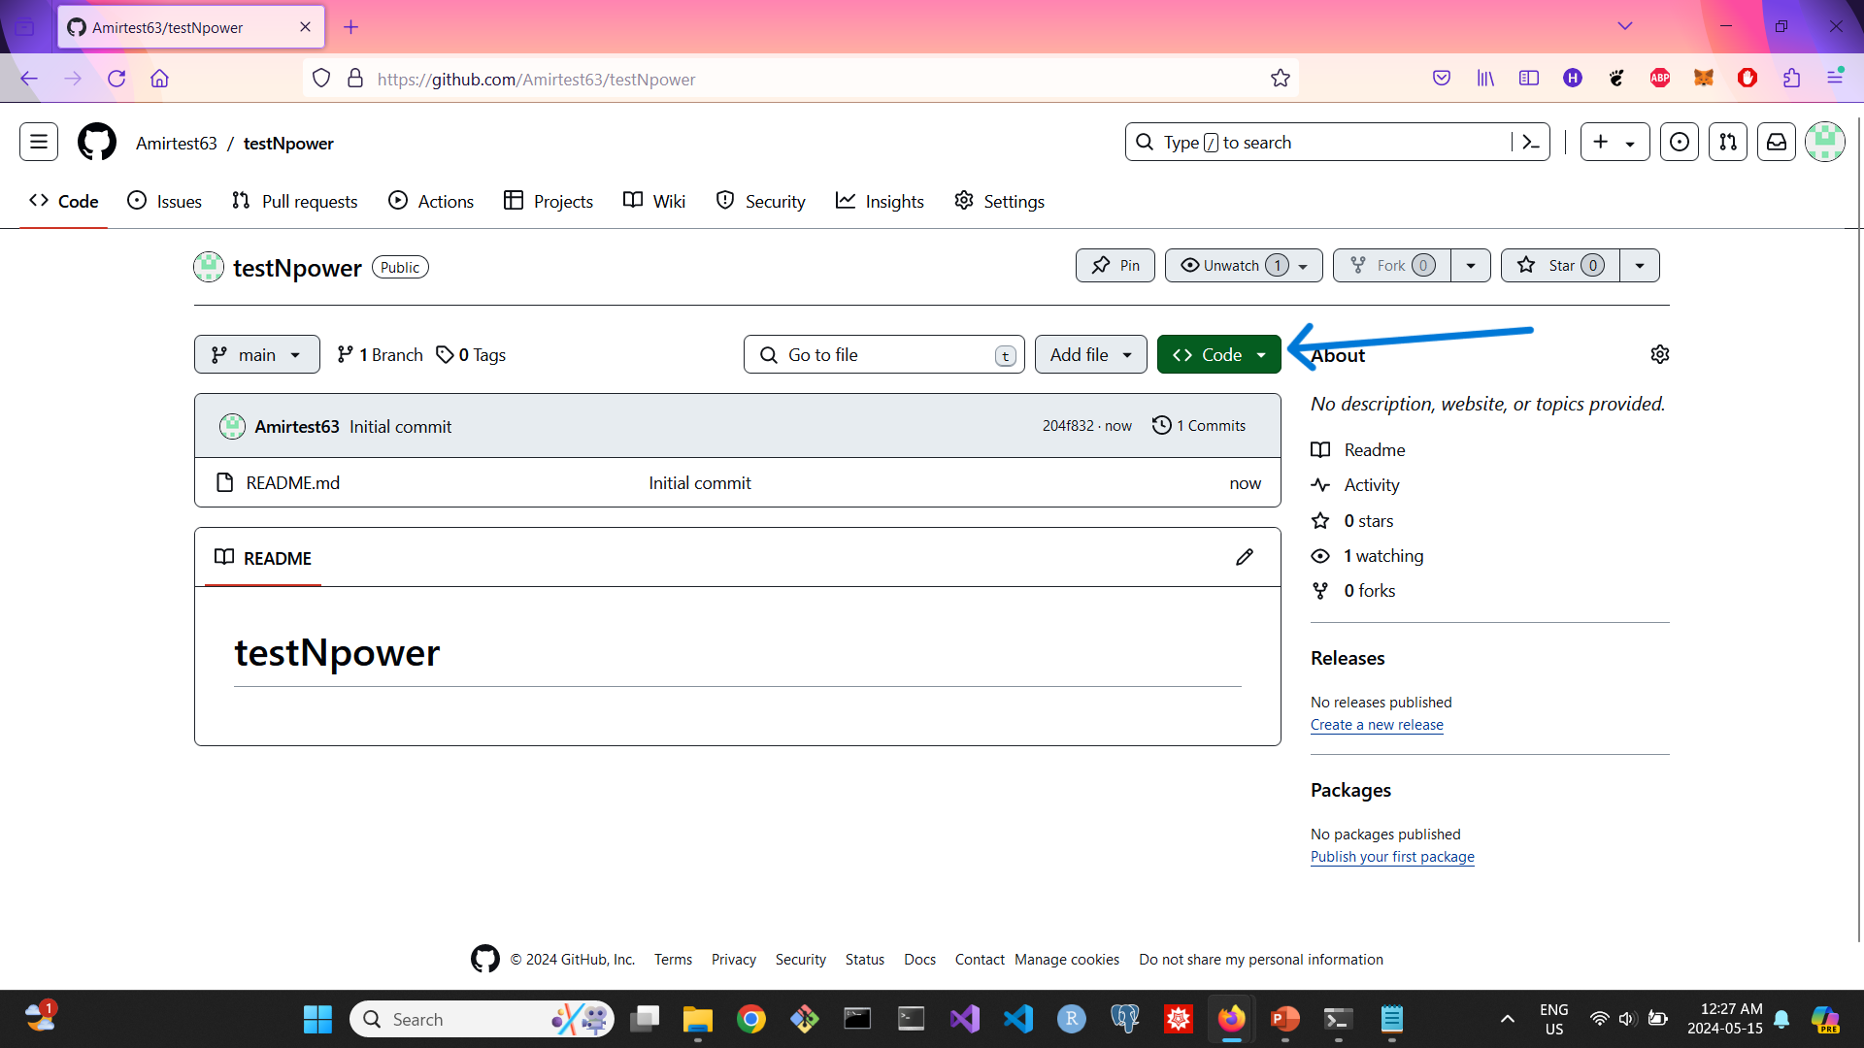
Setting Up Your Repository on GitHub: Creating and Cloning

Slide 17
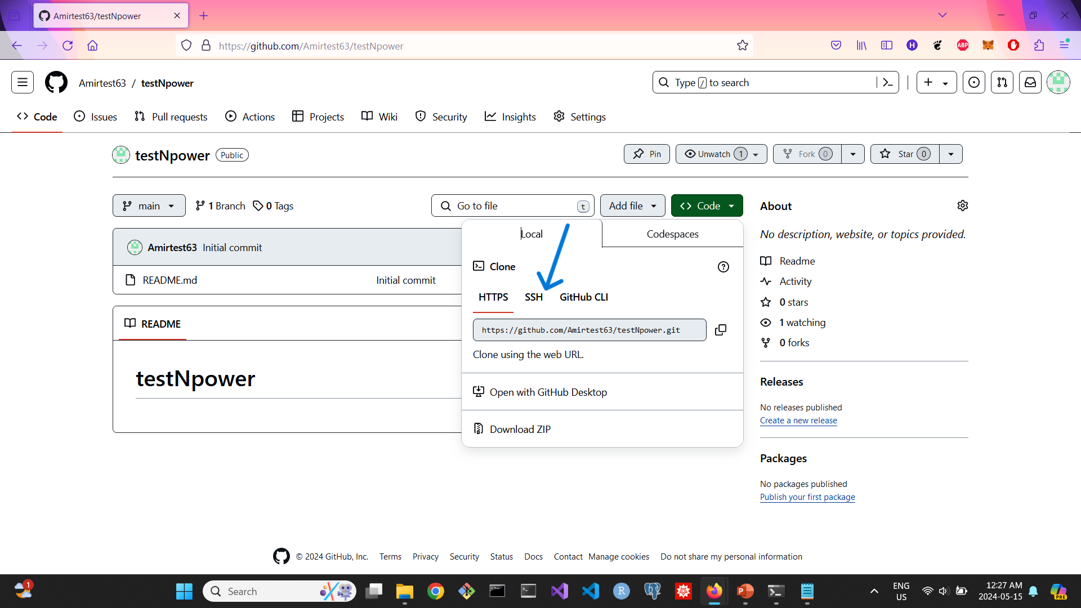
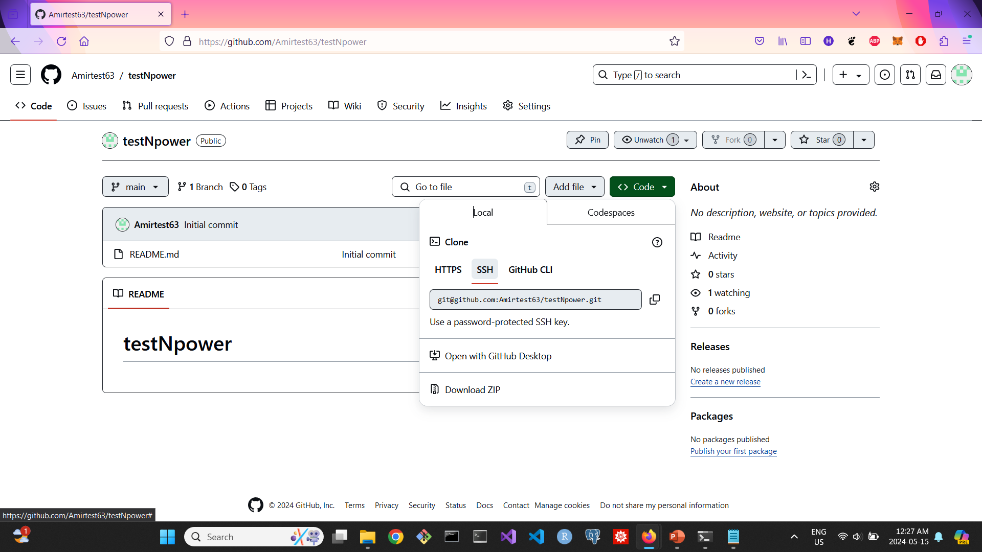
Setting Up Your Repository on GitHub: Creating and Cloning

Slide 18
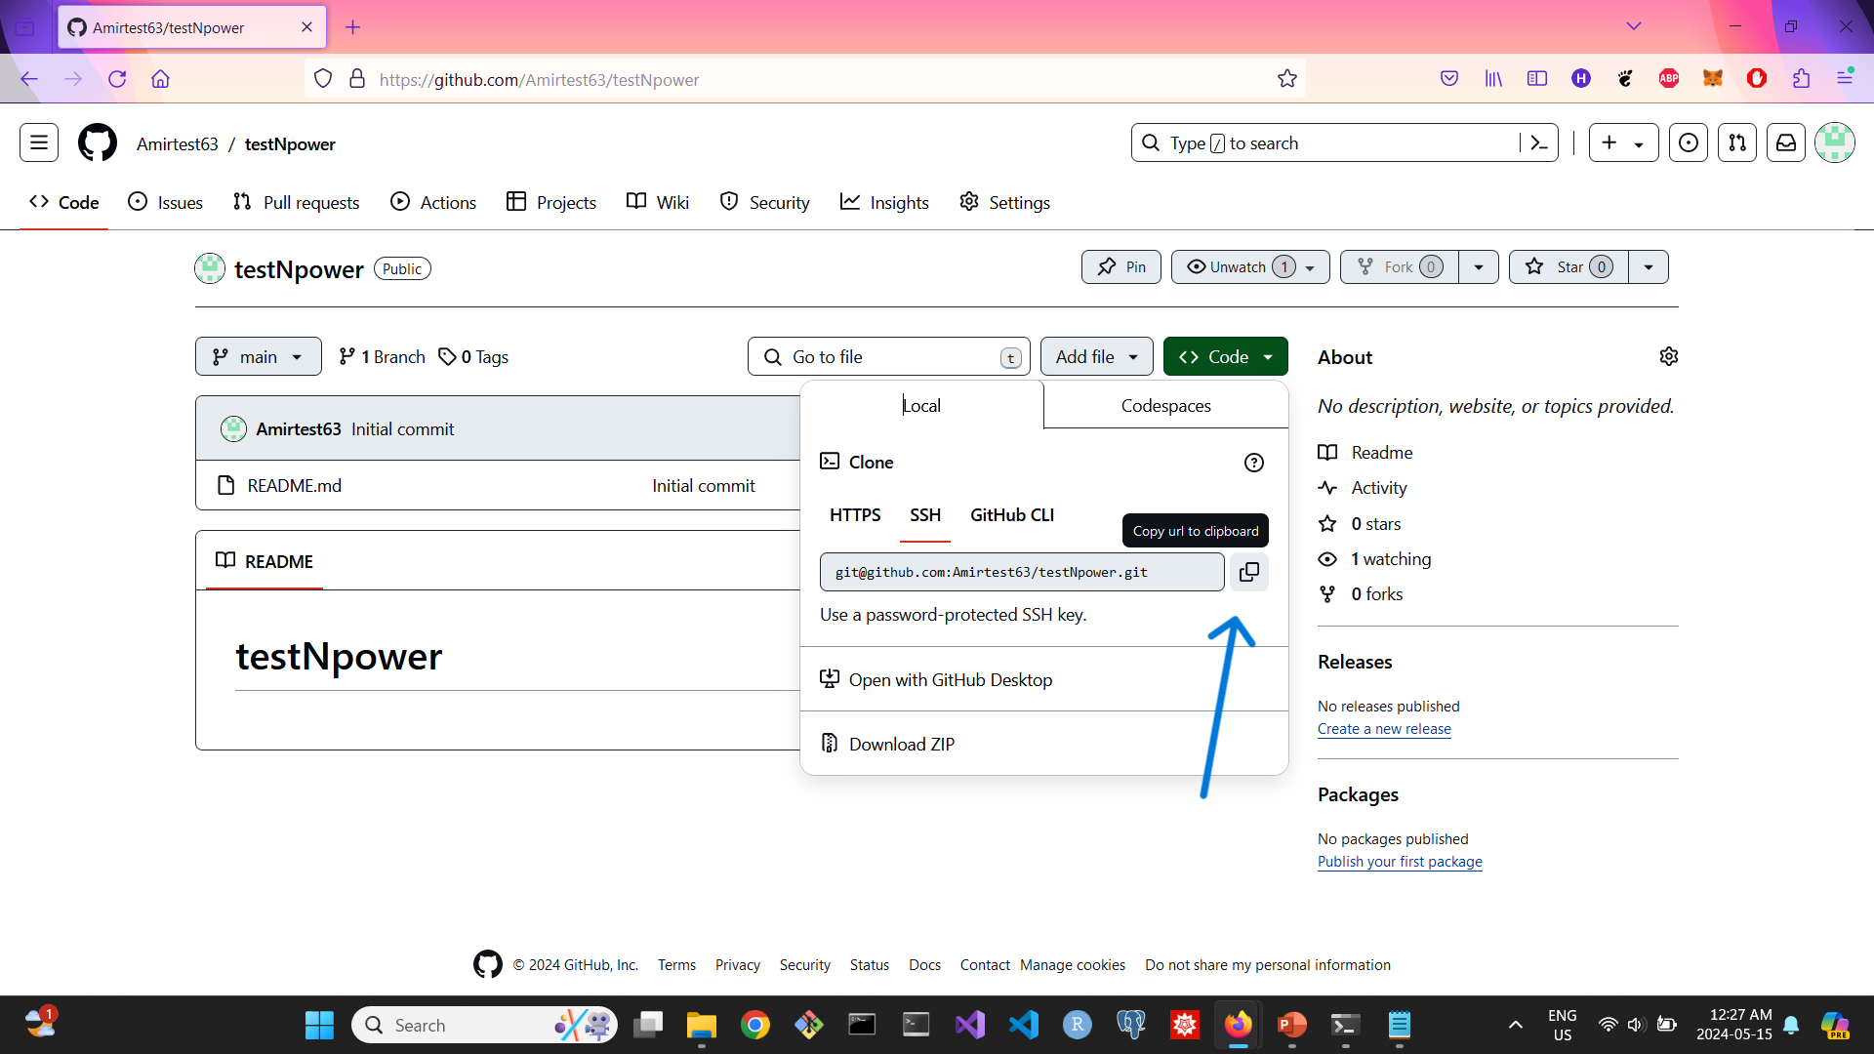
Setting Up Your Repository on GitHub: Creating and Cloning

Slide 19
Streamlining Project Uploads: Cloning a Repository for File Organization
In our scenario, after completing our Python project, consisting of various file types like .py, .sql, .csv, and screenshots, we aim to upload them to a single folder on GitHub. To begin, we create a folder on our local machine, e.g., 'Final Project'. Next, we open Visual Studio Code within this folder and access the terminal. Utilizing the SSH key URL, we execute the command: 'git clone git@github.com:Amirtest63/testNpower.git'. Immediately after executing the 'git clone' command, a folder with the identical name as our GitHub repository, along with a README file, is generated.

Slide 20
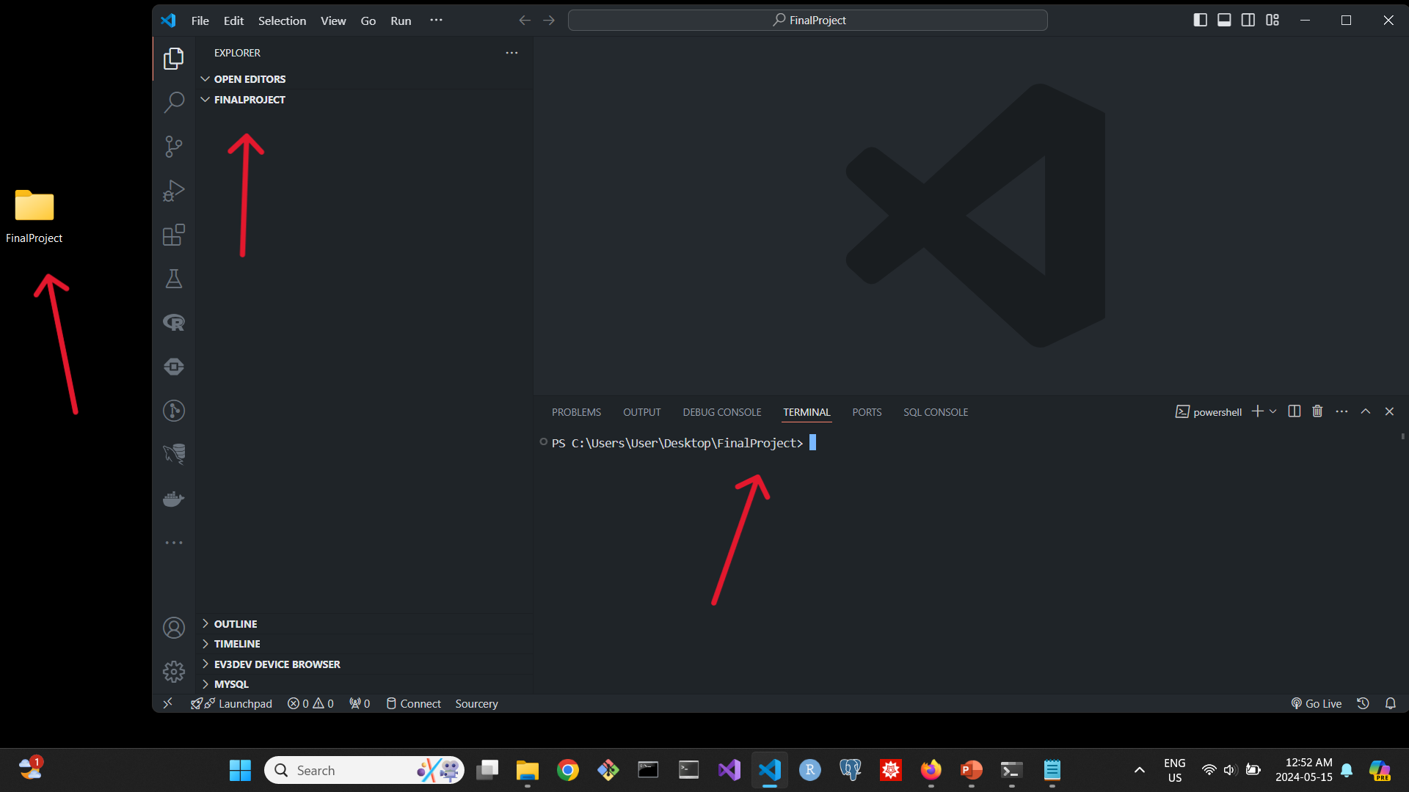
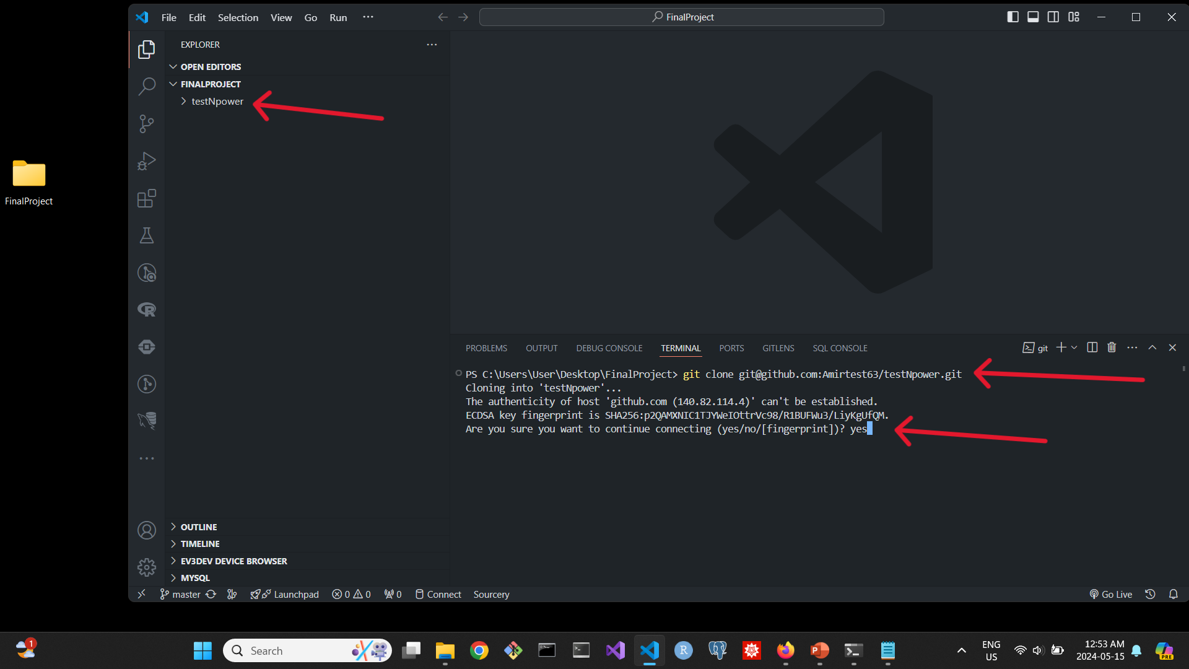
Streamlining Project Uploads: Cloning a Repository for File Organization

Slide 21
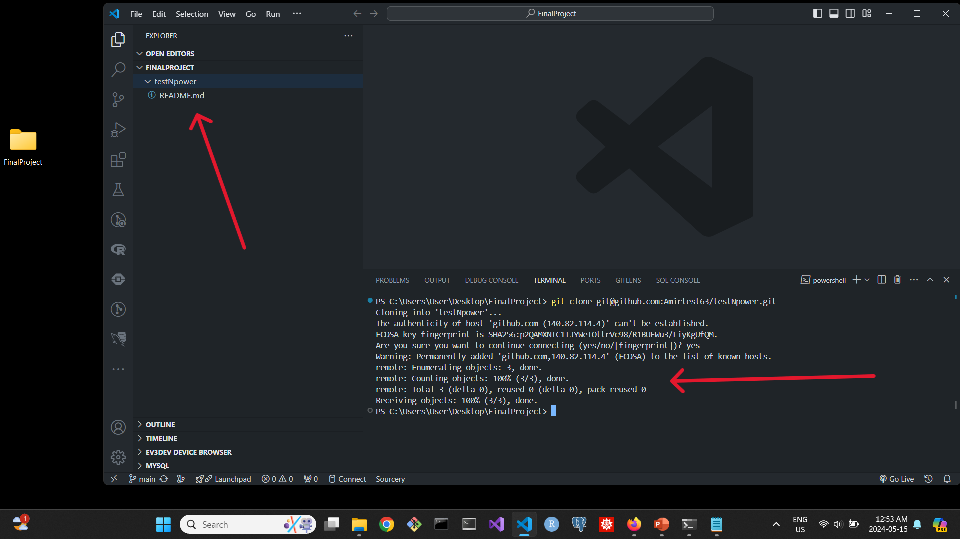
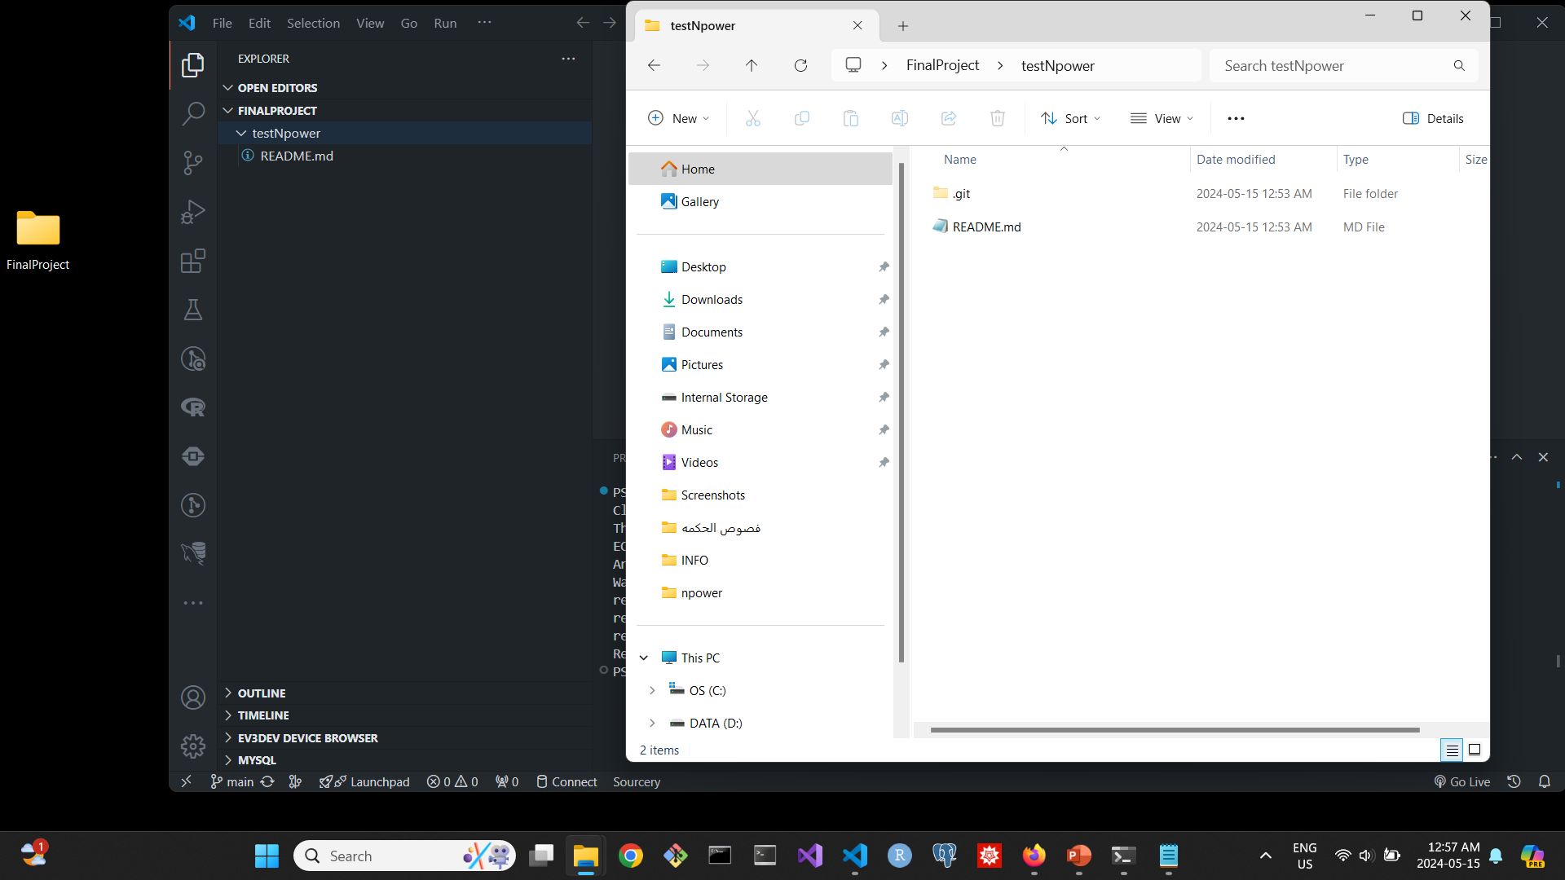
Streamlining Project Uploads: Cloning a Repository for File Organization

Slide 22
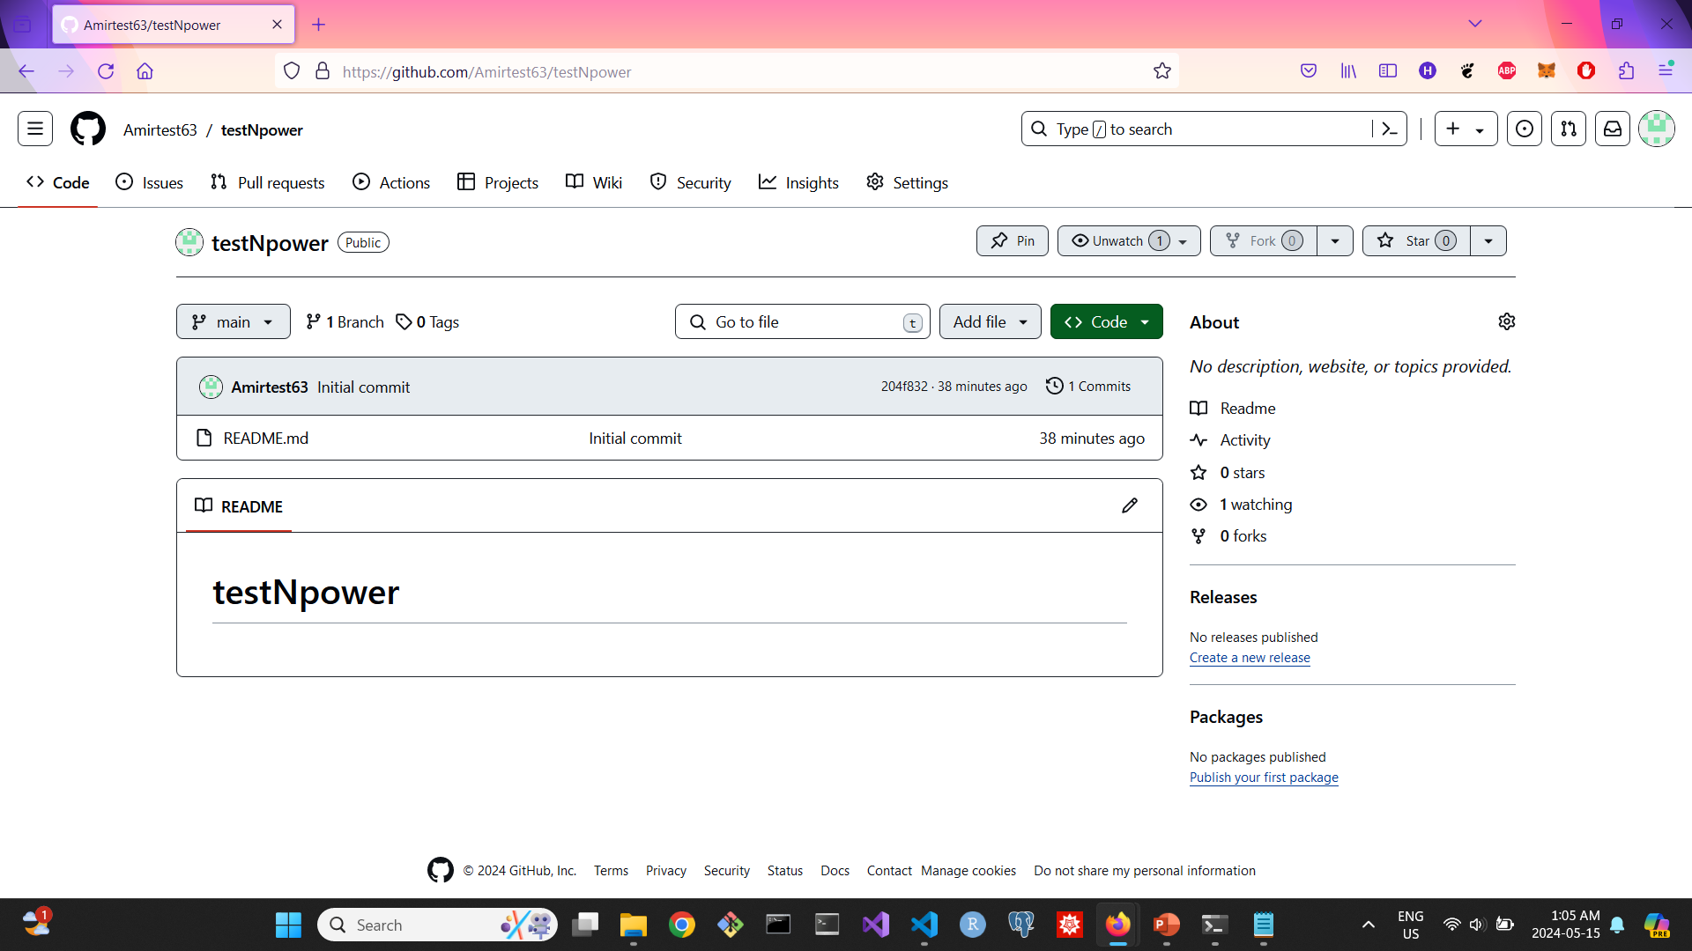
Streamlining Project Uploads: Cloning a Repository for File Organization
We navigate to the 'testNpower' folder containing the README file using the 'cd' command in the terminal. Then, manually, we drag the .py file into the folder. Returning to Visual Studio Code, we execute 'git add .' to stage the changes, followed by 'git commit -m "description of our changes"', and finally 'git push'. The same process applies to updating the README file or any other file.

Slide 23
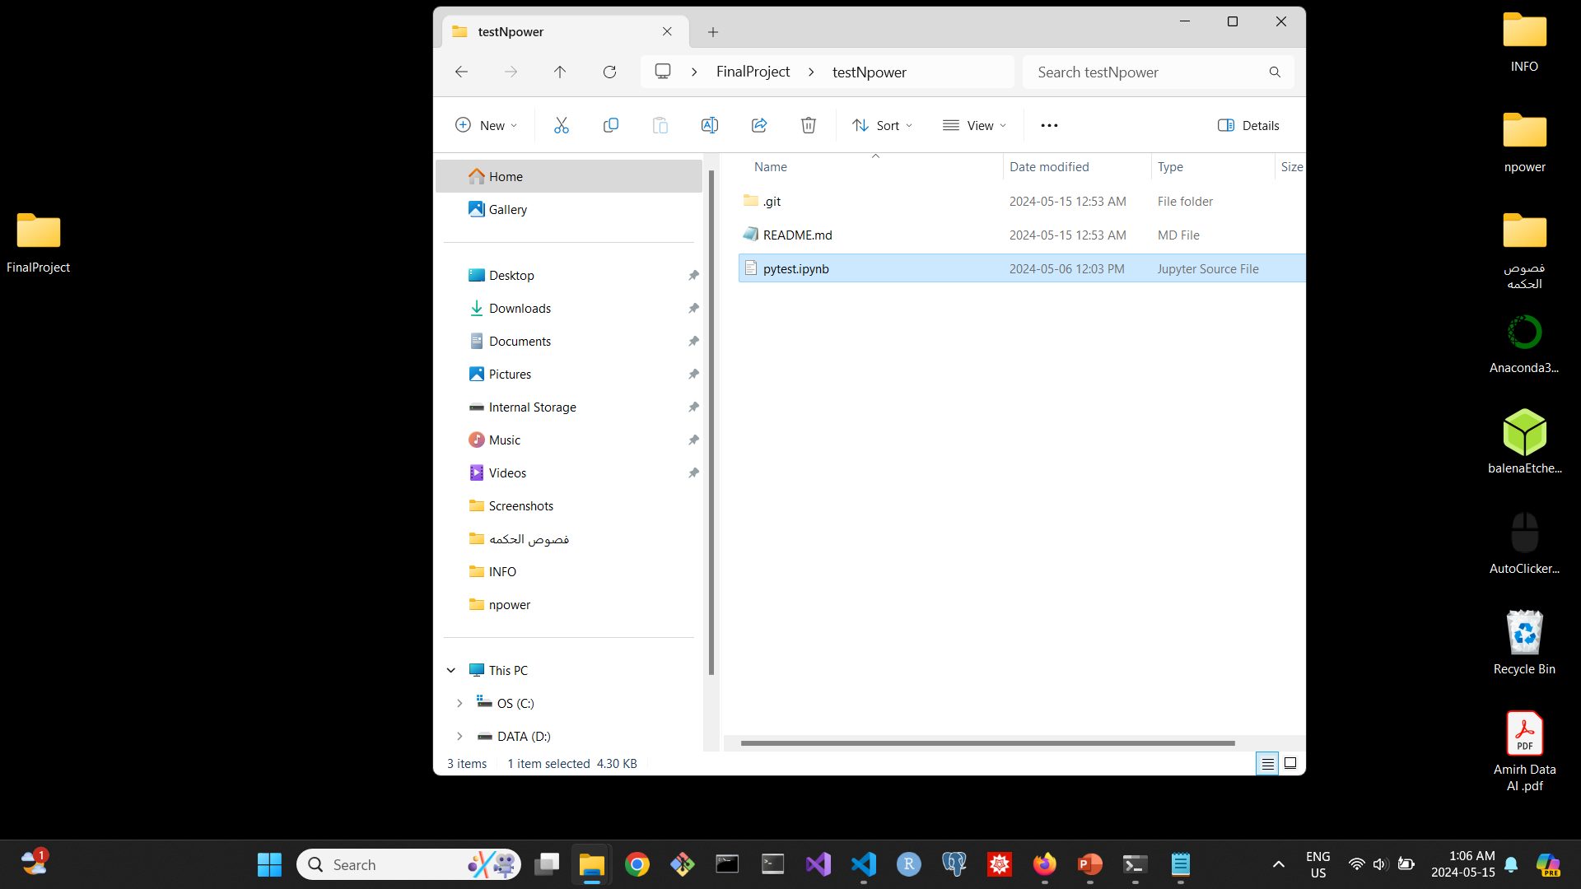
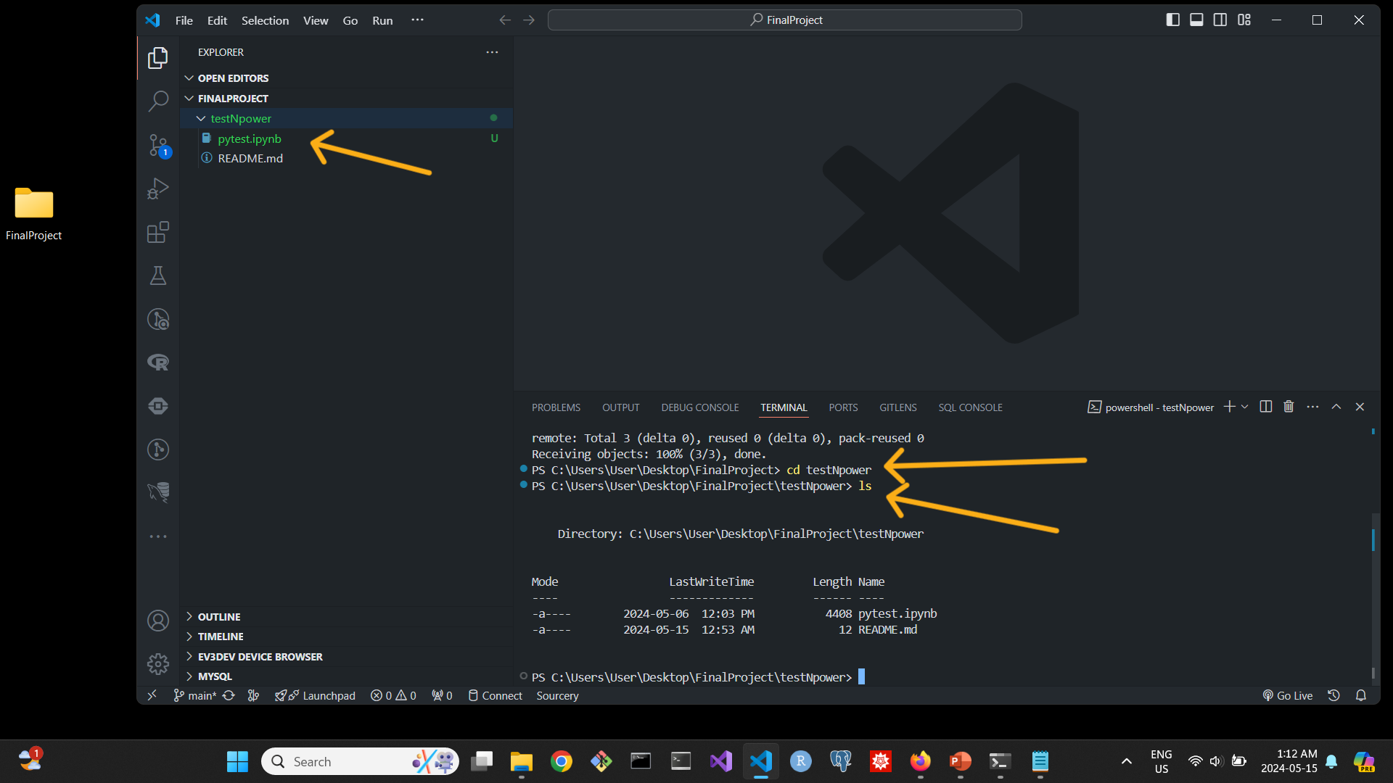
Streamlining Project Uploads: Cloning a Repository for File Organization

Slide 24
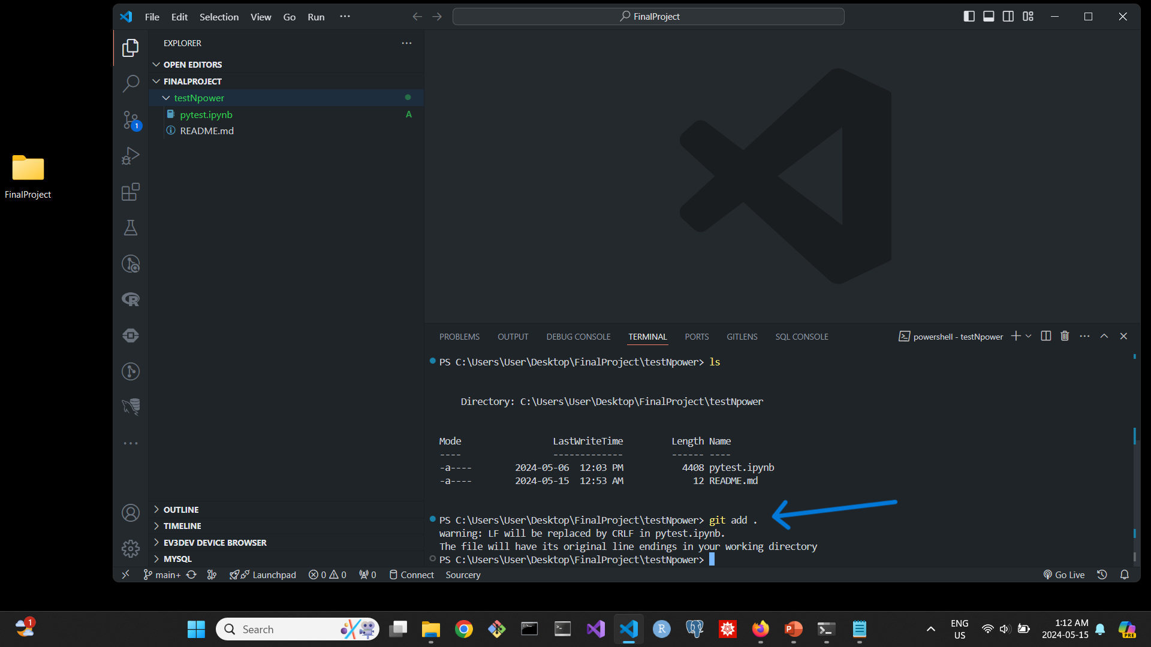

Streamlining Project Uploads: Cloning a Repository for File Organization

Slide 25
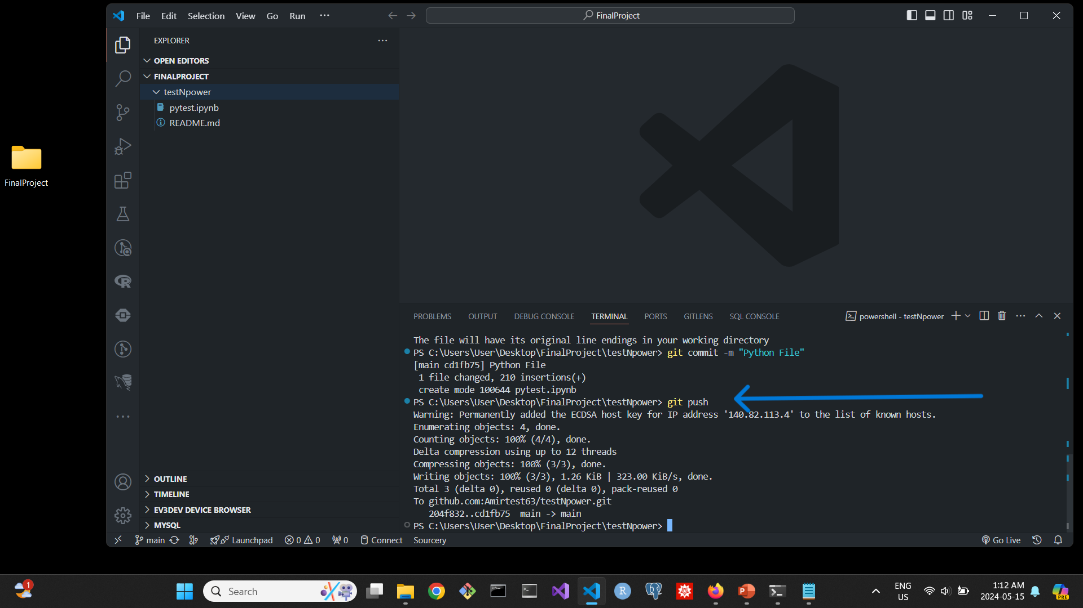
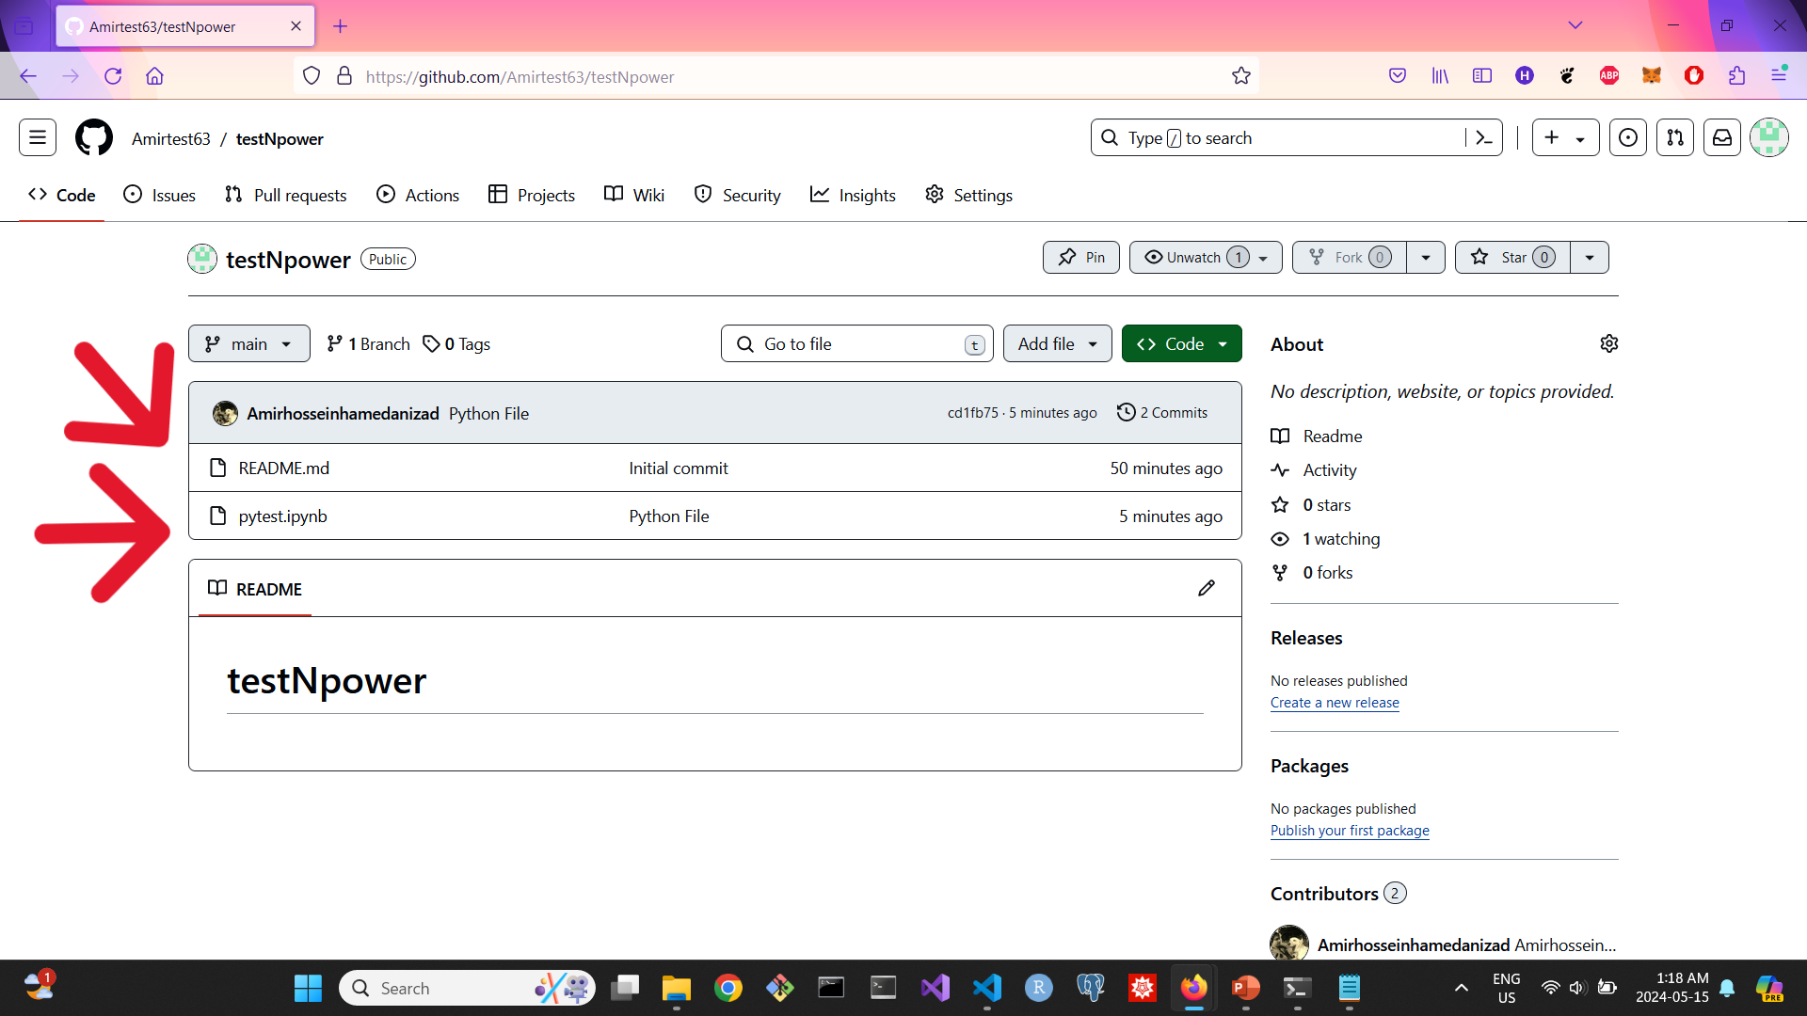
Streamlining Project Uploads: Cloning a Repository for File Organization

Slide 26


Amirhossein Hamedanizad

Slide 27
Thank you for joining us today! If you have any questions or need further assistance, please feel free to reach out to me on LinkedIn. I'm here to help! Happy coding!

